Slide 1
Software testing types

Slide 2
Test Types
Usability
System
GUI
Beta
Integration
Performance
Compatibility
Exploratory
Unit
White Box
Recovery
Sanity
Functional
Regression
Smoke
Install/uninstall
Confirmation
Negative
Localization

Slide 3
Test Types
Functional:
Installation testing
Smoke Testing
Functionality Testing
Compatibility testing
Non-functional:
Security testing
Usability testing
Localization testing and Internationalization testing
Performance testing
Load testing
Stress testing
GUI testing
Confirmation testing, Regression testing

Slide 4

Installation testing
Installation testing, intended to check the successful installation and upgrade or remove the program.

Slide 5
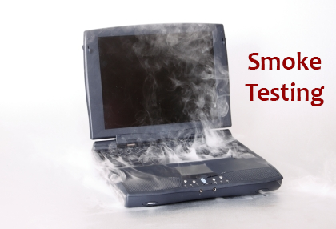
Smoke testing
Smoke testing is performed in order to show that the most necessary functionality of the program (which requires the product).
This testing is done by developers or testers.

Slide 6

Functionality Testing
Functionality testing is done to check that the software operates correctly in accordance with design specifications.

Slide 7
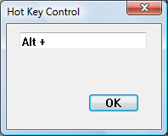
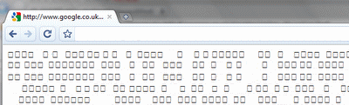
Should check during testing functionality:
Installation and configuration on the local machine
Enter text, including using non-Latin characters or extended.
The main functions of the applications that have not been tested during Smoke testing.
Exact hotkey shortcuts without any duplication.

Slide 8
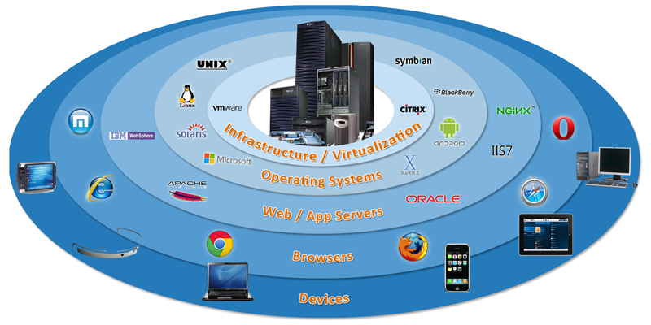
Compatibility testing
Checks whether the application or software compatible with the hardware, operating system, database or other software systems.

Slide 9


Usability testing
Usability testing - is the testing that is necessary to verify that the user interface is easy to use and understand.

Slide 10
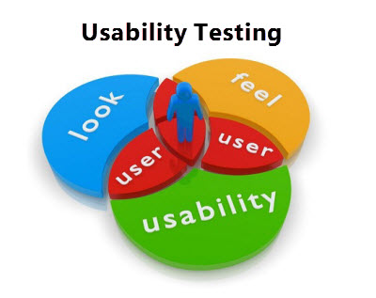
Usability testing
Usability testing can be checked:
Time on Task – How long it takes people to complete basic tasks? (For example, to find something to buy, create a new account and order detail).
Accuracy – How many mistakes did people?
Recall – How people can recall specific action steps after some time did not use the system?
Emotional response – How people will feel themselves after finished task? (Are yon sure? Will users recommend this program to friends?)

Slide 11


Security testing
Security testing - the process of determining what information system protects data and maintains functionality as intended.
Security testing, in general, this type of test that checks whether a program or product is protected or not.
This is a test whether the system is vulnerable to attack if anyone can break the system or enter without any permission.

Slide 12

Localization testing
Localization (L10N) testing checks how well the application under test has been Localized into a particular target language.

Slide 13
Internationalization testing
Internationalization (I18N) testing checks if all data/time/number/currency formats are displayed according to selected locale and if all language specific characters are displayed.
Task:
Verify that list of users with German special characters (e.g.: “ü”, “ß” etc) in names are sorted correctly by ‘First Name’ column

Slide 14
Testing types
Performance
Load
Stress

Slide 15
Performance Testing
Performance testing
Speed
Response time
Stability
Resource usage
Testing with the intent of determining how efficiently a product handles a variety of events.

Slide 16
Criteria: Server should respond in less than 2 sec when up to 100 users access it concurrently. Server should respond in less than 5 sec when up to 300 users access it concurrently.
Performance Testing Procedure: emulate different amount of requests to server in range (0; 300), for instance, measure time for 1, 50, 100, 230 and 300 concurrent users.
Defect: starting from 200 concurrent requests respond time is 10-15 seconds.

Slide 17
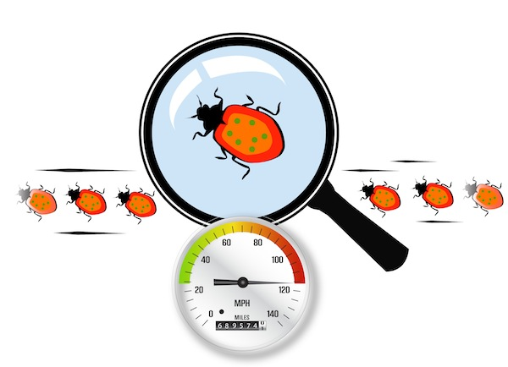
Load Testing
Load testing generally refers to the practice of modeling the expected usage of a software program by simulating multiple users accessing the program's services concurrently.
Load testing is subjecting a system to a statistically representative (usually) load. The two main reasons for using such loads is in support of software reliability testing and in performance testing.

Slide 18
Criteria: Server should allow up to 500 concurrent connections.
Load Testing Procedure: emulate different amount of requests to server close to pick value, for instance, measure time for 400, 450, 500 concurrent users.
Defect: Server returns “Request Time Out” starting from 480 concurrent requests.

Slide 19

Stress testing
Stress testing is a form of testing that is used to determine the stability of a given system or entity.
The idea is to stress a system to the breaking point in order to find bugs that will make that break potentially harmful.

Slide 20
Criteria: Server should allow up to 500 concurrent connections.
Stress Testing Procedure: emulate amount of requests to server greater than pick value, for instance, check system behavior for 510, and 550 concurrent users.
Defect: Server crashes starting from 500 concurrent requests and user’s data is lost.
Data should not be lost even in stress situations. If possible, system crash also should be avoided.

Slide 21

UI testing
User Interface testing is done to verify that the application interface to defined standards.

Slide 22

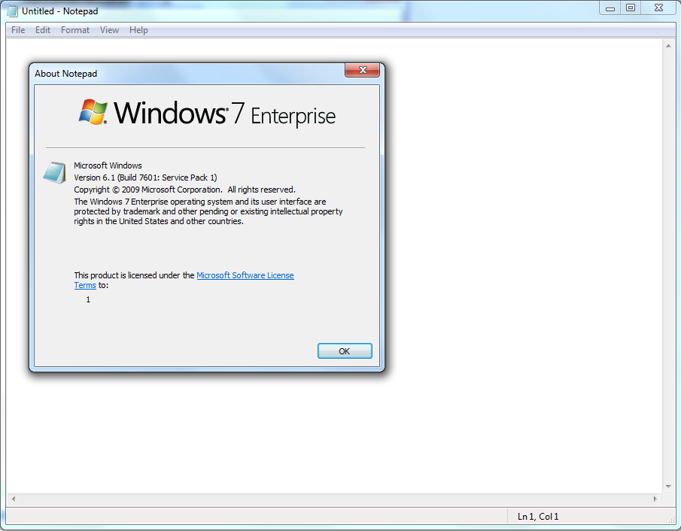
System icon
System icon = About box icon

Slide 23
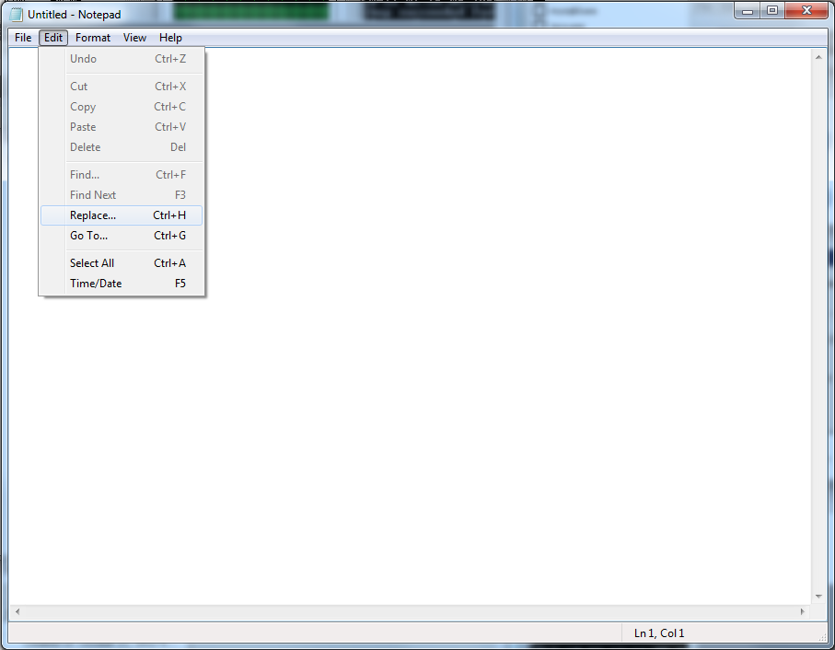
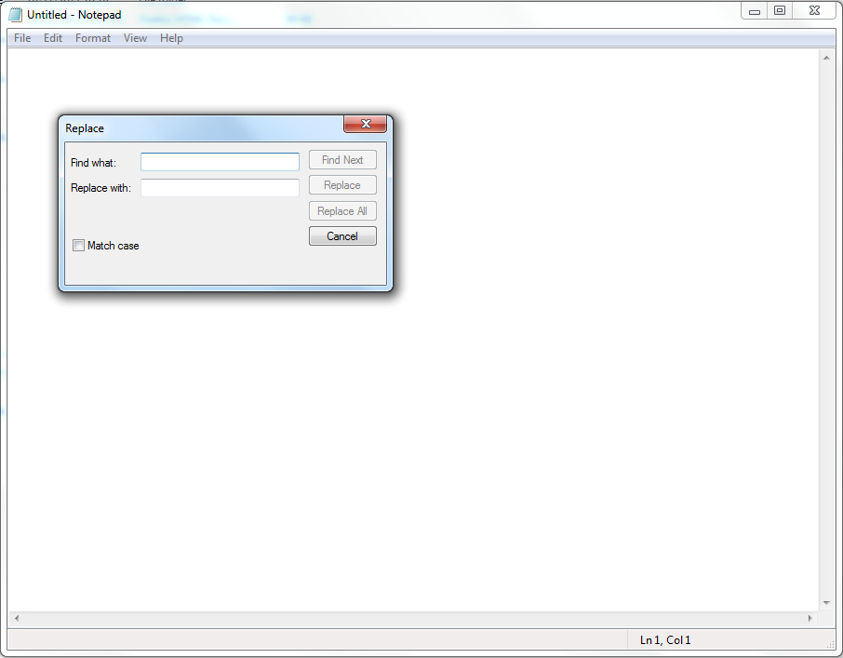
Dialog box title

Slide 24
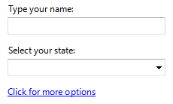
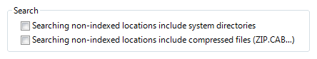
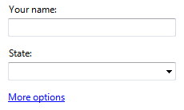
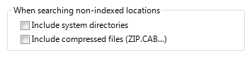
Example
Incorrect:
Incorrect:
Correct:
Correct:

Slide 25
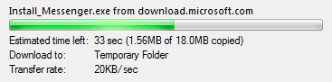
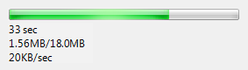
Example
Progress bar details
Correct:
Incorrect:

Slide 26
Example
Navigation links
Links and Text
Incorrect:
Go to a newsgroup.
Correct:
Go to a newsgroup.
Incorrect:
http://www.microsft.com
www.microsoft.com
Correct:
microsoft.com

Slide 27
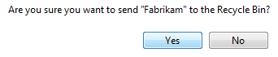
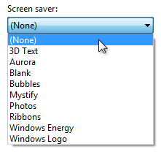
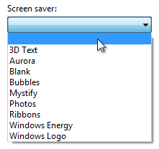
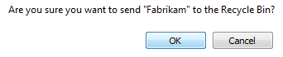
Example
Command buttons
Drop-Down Lists
Correct:
Correct:
Incorrect:
Incorrect:

Slide 28
Regression, Re-testing

Slide 29
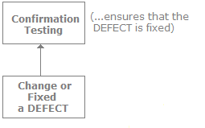
Confirmation testing (re-testing)
Confirmation testing - retesting, which confirms that the bug has been sent. There are words synonymous with re-testing.
It is important to ensure that the test is executed in exactly the same way it was the first time using the same inputs, data and environments.

Slide 30
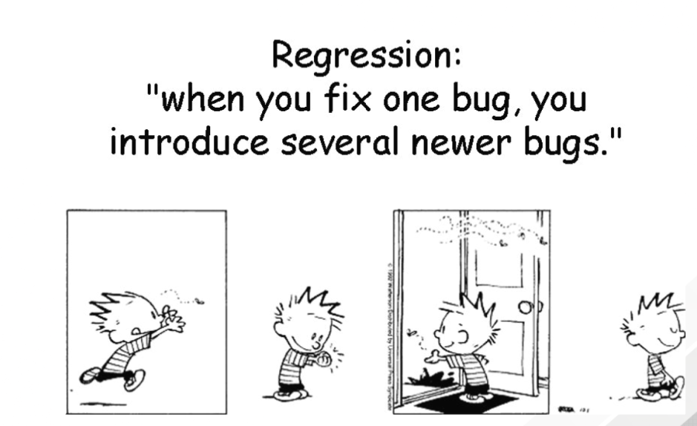
Regression testing
Regression testing is to verify that the changes made in the software (if corrected old bugs) have not led to the emergence of new bugs.
Such errors - when you make changes to the program stops working that would work - called regressive errors.

Slide 31
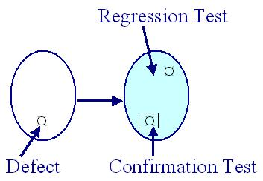
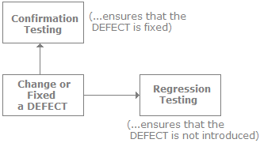
Regression and Confirmation testing

Slide 32
Solving regression testing
a. Prioritizing the test suit and the test cases.
b. Optimization of the test kits.
с. Hiring of new testers.
d Automation regression testing.

Slide 33
Regression Testing Tools
Example regression testing tools are:
Win runner
QTP
AdventNet QEngine
Regression Tester
vTest
Watir
Selenium
actiWate
Rational Functional Tester
SilkTest

Slide 34
Proactive and Reactive
Manual and Automated
Verification and Validation
Box-techniques
Positive and Negative
Scripted and Unscripted

Slide 35
Proactive testing
Proactive behavior involves acting in advance of a future situation, rather than just reacting.
Test design process is initiated as early as possible in order to find and fix the defects before the build is created
Reactive testing
Reactive behavior is reacting to problems when they occur instead of doing something to prevent them
Testing is not started until design and coding are completed

Slide 36

Manual and Automated

Slide 37
Manual
Manual testing is the process through which software developers run tests manually, comparing program expectations and actual outcomes in order to find software defects
Automated
Automated testing is the process through which automated tools run tests that repeat predefined actions, comparing a developing program’s expected and actual outcomes

Slide 38
Manual Testing | Automated Testing
Time consuming and tedious: Since test cases are executed by human resources so it is very slow and tedious. | Fast: Automation runs test cases significantly faster than human resources.
Less reliable: Manual testing is less reliable as tests may not be performed with precision each time because of human errors. | More reliable: Automation tests perform precisely same operation each time they are run.
Self-contained: Manual testing can be performed and completed manually and provide self-contained results. | Not self-contained: Automation can’t be done without manual testing. And you have to manually check the automated test results.
Implicit: Implicit knowledge are used to judge whether or not something is working as expected. This enables engineer to find extra bugs that automated tests would never find. | Explicit: Automated tests execute consistently as they don’t get tired and/or lazy like us humans.

Slide 39


Verification and Validation
Are we building
the right product?
Are we building
the product right?
To ensure that the product actually meets the user’s needs, and that the specifications were correct in the first place.
To ensure that work products meet their specified requirements.

Slide 40
Examples
Designer designs a new car according the requirements of his client. After producing the prototype he verifies that the prototype is according to the requirements.
The next step before going to the mass production is to check in "real conditions" if the prototype does that what the client thought it would do (validation).

Slide 41


Black-box, White-box, Grey-box
Black-box Testing is a software testing method in which the internal structure/ design/ implementation of the item being tested is NOT known to the tester.
White-box Testing is a software testing method in which the internal structure/ design/ implementation of the item being tested is known to the tester.
Black-box Testing | White-box Testing
Levels Applicable To: System, Acceptance Test Levels | Levels Applicable To: Component, Integration Test Level
Responsibility: Quality Control Engineers | Responsibility: Software Developers
Grey-box Testing is a software testing method which is a combination of Black-box and White-box Testing methods.

Slide 42


Positive testing
Negative testing
to prove that an application will work on giving valid input data. i.e. testing a system by giving its corresponding valid inputs or actions.
to prove that an application will give correct behavior on giving invalid inputs or actions.
Positive and Negative

Slide 43
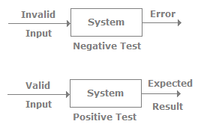
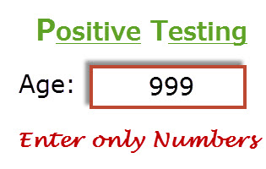
Examples

Slide 44


Scripted and Unscripted
Scripted testing
Unscripted testing
Test execution carried out by following a previously documented sequence of tests.
Test execution carried out without previously documented sequence of tests.

Slide 45
Exploratory testing
Ad-hoc testing
An informal test design technique where the tester actively controls the design of the tests as those tests are performed and uses information gained while testing to design new and better tests
Testing carried out informally; no formal test preparation takes place, no recognized test design technique is used, there are no expectations for results and
arbitrariness guides the test execution activity
Unscripted testing
Exploratory Testing | Ad-hoc Testing
Aim: to get the information to design new and better tests | Aim: to find defects
Result: defects are found and registered; new tests are designed and documented for further usage | Result: defects are found and registered

Slide 46
Mobile testing
Criteria | Android | iOS
Company | Google | Apple
OS family | Linux | OS X, Linus
Programmed in | C, C++, apps in Java | C, C++, apps in Objective S
Source model | Open source | Closed source
Manufacturer | LG, Samsung, HTC, Sony, ASUS, Motorola | Apple
Widgets | Yes, on the desktop and in the notification center | Yes, within the notification center
Interfaces | Touchscreen | Touchscreen
Voice commands | Google now | Siri
Maps | Google Maps | Apple Maps
Available languages | 32 languages | 34 languages
App store | Google Play | Apple App store

Slide 47
Apple Standards
https://developer.apple.com/design/#//apple_ref/doc/uid/TP40013289
https://developer.apple.com/app-store/review/guidelines/
https://developer.apple.com/ios/human-interface-guidelines/overview/themes/

Slide 48
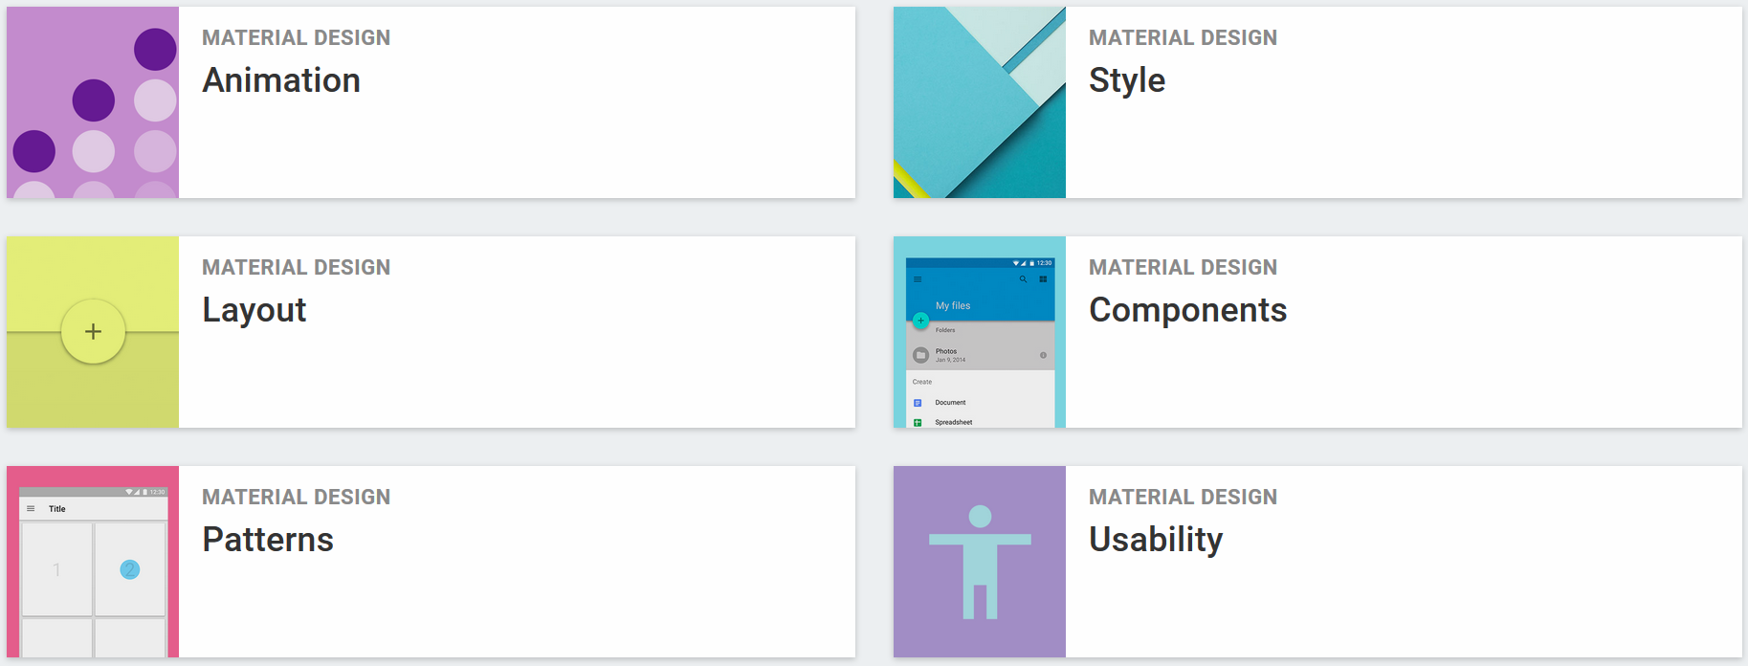
Google Standards

Slide 49
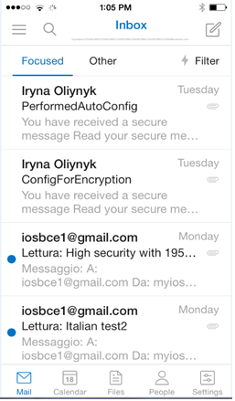
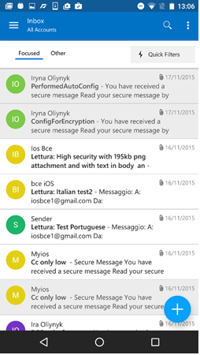
Consistency across platform
Outlook application on iOS Outlook application on Android

Slide 50
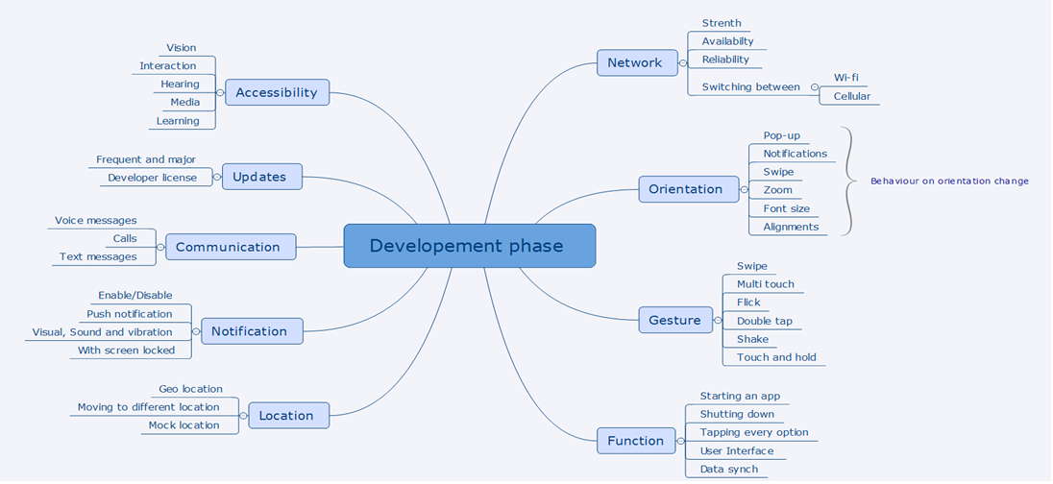

Slide 51

Simulators & Emulators

Slide 52
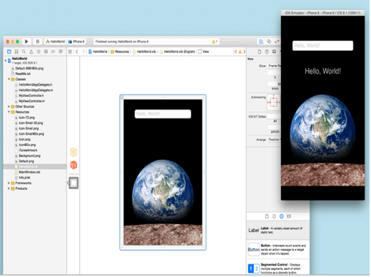
Simulators on iOS
https://developer.apple.com/library/content/documentation/IDEs/Conceptual/iOS_Simulator_Guide/Introduction/Introduction.html

Slide 53
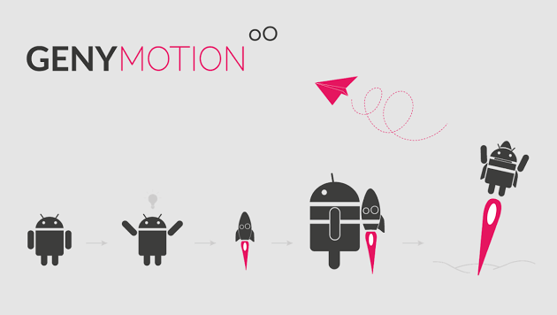
Emulators on Android
https://www.genymotion.com/

Slide 54
App publishing process
Knowledge of the different review guidelines will allow you to better support your team while developing and releasing your app. The review and publishing guidelines of the major mobile app stores can be found on the following Web sites:
Amazon Appstore Guidelines (https://developer.amazon.com/help/faq.html)
Apple App Store Guidelines (https://developer.apple.com/app-store/review/)
BlackBerry World Guidelines (http://developer.blackberry.com/blackberryworld/vp_checklist.html)
Google Play store Guidelines (http://developer.android.com/distribute/googleplay/publish/preparing.html)
Samsung App Store Guidelines (http://developer.samsung.com/distribute/app-submission-guide)
Windows Phone Store Guidelines (http://msdn.microsoft.com/en-us/library/windows/apps/br230835.aspx)

Slide 55


